Slide 1

Principles of Program Design: Problem Solving with JavaScript
Chapter 2
The JavaScript Language

Slide 2
Objectives
In this chapter, you learn to:
Describe generations of computer languages and explain the difference between compiled and interpreted languages
Summarize the history of the Internet and JavaScript
Explain the relationship between JavaScript and HTML
Convert pseudocode into JavaScript code
Write JavaScript statements for getting user input

Slide 3
Introduction
Advantages of using JavaScript
  No installation required
  Runs in a Web browser
  No Internet connection needed
  Can use any text editor
  No compiling necessary
    Three HTML tags allow the program to run

Slide 4
Types of Programming Languages
First-generation languages (1GLs)
  Machine languages
  Written in binary code
Second-generation languages (2GLs)
  Assembly languages
  Refers to registers (memory locations)
Third-generation languages (3GLs)
  Examples: FORTRAN, LISP, ALGOL, COBOL, BASIC, Pascal, C

Slide 5
Types of Programming Languages (cont’d.)
Third-generation languages (cont’d.)
  Focus on steps to solve the problem
  Visual Basic was among first to have integrated development environment
  C was enhanced to C++ (object-oriented language)
Translating source code into machine language
  Compiling
    Complete program is translated before running
  Interpreting
    Translated and executed line by line

Slide 6
Types of Programming Languages (cont’d.)
Advantages of compiled programs
  Free of syntax errors
  Run faster
Disadvantages
  Need a compiler for each operating system
Advantage of interpreted programs
  Can be modified and tested immediately
JavaScript interpreted by a Web browser

Slide 7
Types of Programming Languages (cont’d.)
Fourth-generation languages (4GLs)
  Application specific
  Associated with visual interfaces and natural languages
Scripting language
  Doesn’t run as a separate program
  JavaScript is an example

Slide 8
History of the Internet and JavaScript
Concept of Internet
  1960s research papers
Department of Defense
  1960s: ARPANET
National Science Foundation
  1980s: NSFNET
Searching tools invented early 1990s
Minicomputers becoming common in 1970s

Slide 9
History of the Internet and JavaScript (cont’d.)
Local area networks first used in 1980s
Personal computer growth
  Apple II 1977
  IBM PC 1981
Hypertext Markup Language (HTML)
  Invented by Tim Berners-Lee in 1989
Graphical browser
  Mosaic 1993
  Netscape Navigator 1994

Slide 10
History of the Internet and JavaScript (cont’d.)
JavaScript
  Developed to address need for user interaction with Web sites
  Created by Brandon Eich of Mozilla
  First used in 1995
World Wide Web
  Web server
  Web site
  Client

Slide 11
History of the Internet and JavaScript (cont’d.)
HTML tags for JavaScript
  Identify sections of a Web page
  Consist of a pair of angle brackets < >
    Identifier inside the brackets
  Example: <b> stands for bold format
  Closing tag </b >

Slide 12
History of the Internet and JavaScript (cont’d.)
Tags needed to set up section for JavaScript
  Preceding tags
  <html>
  <body>
  <script type= "text/javascript">
  Matched with closing tags in reverse order
  </script>
  </body>
  </html>

Slide 13
History of the Internet and JavaScript (cont’d.)
Attribute-value pair
  Example: <script type= " text/javascript" >
  Indicates type of script that needs to be identified
  Value text/javascript
    Tells Web browser script is in text format
    Script type is JavaScript

Slide 14
History of the Internet and JavaScript (cont’d.)
XHTML and HTML 5
  Extended HTML (XHTML)
    Features user-defined tags to describe data
    Contains content of data
    Leaves formatting to external documents
    Able to validate code
HTML 5
  Work began in 2009
  Will include new tags and capabilities
    Syntax checking

Slide 15
From Pseudocode to JavaScript
JavaScript considered an object-oriented language
  But doesn’t allow programmer-defined classes
Comparing pseudocode and JavaScript statements
  Empty set of parentheses used for statement requiring arguments
  Example: document.write()
  Object named first
  Next: a period and name of action
  Parentheses may contain arguments

Slide 16
From Pseudocode to JavaScript (cont’d.)
Comparing pseudocode and JavaScript statements (cont’d.)
  Example of pseudocode statement:
  Display "Welcome to the Payroll Statement Program!"
  Equivalent JavaScript statement
  document.write("Welcome to the Payroll Statement Program!");
  Semicolon used to separate statements

Slide 17
From Pseudocode to JavaScript (cont’d.)
Create your first JavaScript program
  Use any text editor
    Notepad and Windows 7 used in the book
    Mozilla Firefox for screenshots
  Keep HTML and JavaScript files in the same folder
    On the same drive
  Begin comments with two slashes //
  Follow instructions for Program 2-1 on pages 53-55

Slide 18
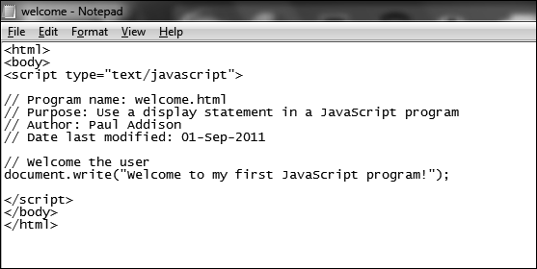
From Pseudocode to JavaScript (cont’d.)
Figure 2-1 The welcome.html program in Notepad

Slide 19
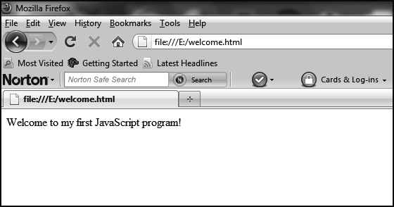
From Pseudocode to JavaScript (cont’d.)
Figure 2-2 The welcome.html program in a Web browser

Slide 20
From Pseudocode to JavaScript (cont’d.)
Common mistakes
  Tag identifiers misspelled
  Tags not closed correctly
  Single slashes instead of double for comments
  Missing quotation mark in <script> tag
  Missing parenthesis or quotation mark in the document.write() line

Slide 21
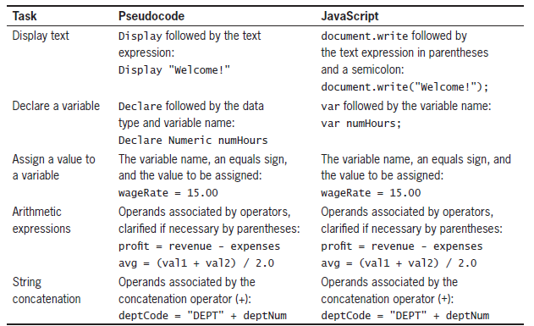
From Pseudocode to JavaScript (cont’d.)
Table 2-1 Pseudocode and JavaScript equivalents

Slide 22
From Pseudocode to JavaScript (cont’d.)
JavaScript
  Does not require declaring data type
  No separate declaration for constants
  Doesn’t go to the next line:
    Until the line is full
    Or line break tag is used

Slide 23
From Pseudocode to JavaScript (cont’d.)
JavaScript input
  Function for receiving input:(prompt)
  Prompt box with instructions and two options:
    OK and cancel
  May supply a default value
  User-entered value stored in a variable
  Syntax:
  variablename=prompt("prompt text", "optional default value");

Slide 24
From Pseudocode to JavaScript (cont’d.)
JavaScript input (cont’d.)
  Example:
  var lastName=prompt("Enter the employee’s last name: ", " ");
  If user types something in the text box and clicks OK, text assigned to lastName
  If user clicks OK without entering input, default text (if provided) assigned to lastName
  If no default text, empty string assigned
  If user clicks Cancel, nothing assigned

Slide 25
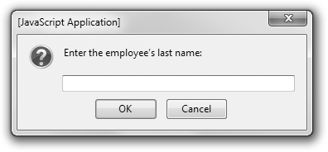
From Pseudocode to JavaScript (cont’d.)
Figure 2-3 A prompt box displayed in Firefox

Slide 26
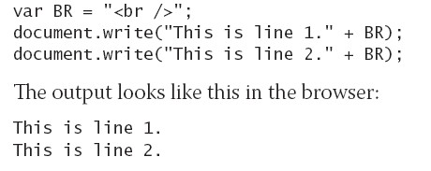
From Pseudocode to JavaScript (cont’d.)
Line break
  Use to make text appear on next line
  Two separate statements will appear on same line:
    If no line break is used
  Line break can be a named constant
  Example:

Slide 27
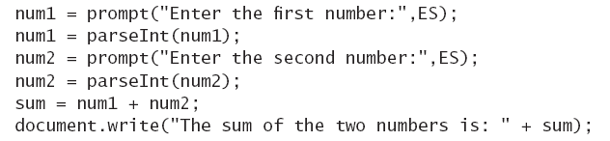
From Pseudocode to JavaScript (cont’d.)
Anything entered into text box is stored as text
  An entered number is stored as a string of digits
    Calculations will give unexpected results
Can convert text data into numeric format
  Syntax:
  Example:

Slide 28
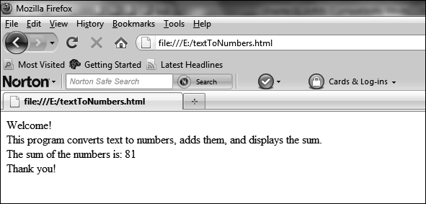
From Pseudocode to JavaScript (cont’d.)
Create JavaScript Program 2-2 on pages 60-61
  Output should look like Figure 2-4
Figure 2-4 The textToNumbers.html program in a Web browser

Slide 29
From Pseudocode to JavaScript (cont’d.)
Converting complete pseudocode programs to JavaScript
  End JavaScript statements with semicolon
  Declare variables with var
    Use camel casing
  Do not specify data type
  Constants are declared as variables
    Use uppercase letters and underscores

Slide 30
From Pseudocode to JavaScript (cont’d.)
Converting complete pseudocode programs to JavaScript (cont’d.)
  Display/Input pairs are replaced with prompt() function
    Followed by parseInt()or parseFloat() if variable is numeric
  Display statements become document.write() statements
  Use constants for string literals for easier reading

Slide 31
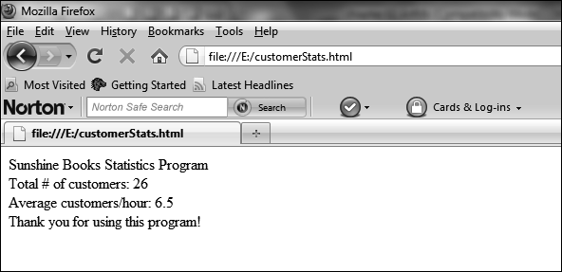
From Pseudocode to JavaScript (cont’d.)
Complete Program 2-3 on pages 63-65
Output should look like Figure 2-5
Figure 2-5 The customerStats.html file in a Web browser

Slide 32
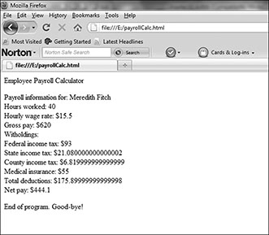
From Pseudocode to JavaScript (cont’d.)
Complete the Programmer’s Workshop on pages 65-70
Output should look like Figure 2-6:
Figure 2-6 The first version of payrollCalc.html, after all prompts have been answered

Slide 33
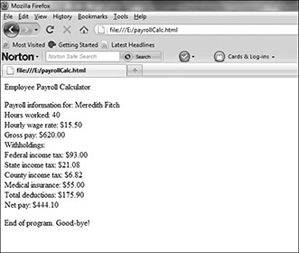
From Pseudocode to JavaScript (cont’d.)
Revise the Programmer’s Workshop on pages 71-72
Output should look like Figure 2-7
Figure 2-7 The second version of payrollCalc.html, changed to display two decimal places for dollar amounts

Slide 34
Summary
Earliest programming languages: binary and assembly languages
Third-generation languages: high-level or procedural languages
Compiling and interpreting are two methods of translating code into machine language
JavaScript: a scripting language and an interpreted language
The history of the Internet began in the 1960s

Slide 35
Summary (cont’d.)
HTML and XHTML: markup languages
Pseudocode algorithms can be easily converted to scripting or programming languages
JavaScript receives input using a prompt box
JavaScript program statements end with semicolon
Good programming practices
  Develop one section at a time
  Test programs as you build them
  Use comments
  Back up your work

